Slide 1
SKETCH TO COLOUR ANIME TRANSLATION USING GAN
PRESENTED BY:
M.BARATHKUMAR
513121104302
III Year CSE
TPGIT, Vellore

Slide 2
AGENTA
Problem Statement
Proposed Solution
Who are the end users
The WOW in my solution
System Development Approach
Algorithm and Deployment
Result
Conclusion

Slide 3

PROBLEM STATEMENT
Develop a system that translates rough sketches of anime characters into fully colored images using Generative Adversarial Networks (GANs). The challenge lies in accurately interpreting the sketch's lines, shapes, and proportions, and then generating realistic color distributions to mimic the original artwork. This involves overcoming the ambiguity and variability inherent in hand-drawn sketches and ensuring that the final colored images maintain the style and essence of anime artwork. The system must also address issues such as preserving fine details, maintaining consistency across different parts of the image, and handling variations in shading and texture to produce high-quality results. Additionally, the translation process should be efficient and scalable to handle a wide range of input sketches while minimizing computational resources and time requirements.

Slide 4

PROPOSED SOLUTION
Utilize a Conditional Generative Adversarial Network (c-GAN) architecture to tackle the sketch-to-color anime translation problem. The c-GAN framework will enable the incorporation of conditional information from the input sketches, guiding the generation process towards more accurate and style-consistent colorization.
1. Data Preprocessing: Prepare a dataset consisting of paired sketch-color image samples, ensuring a diverse range of anime styles, characters, and poses. Normalize and preprocess the data to ensure consistency in input format and quality.
2. Architecture Design: Design a c-GAN model comprising a generator and a discriminator. The generator network will take input sketches and conditioning information (e.g., sketch category or character identity) and output corresponding colored images. The discriminator will assess the realism of the generated images relative to real colored images.
3. Training Strategy: Train the c-GAN model using adversarial training, where the generator aims to fool the discriminator by generating convincing colorizations, while the discriminator aims to distinguish between real and generated images accurately. Incorporate techniques such as mini-batch discrimination and spectral normalization to stabilize training and improve convergence.

Slide 5
4. Loss Function: Define appropriate loss functions to guide the training process. Utilize a combination of adversarial loss, perceptual loss (e.g., VGG feature loss), and conditional information loss to ensure both visual fidelity and style consistency in the generated images. 5. Conditional Input Handling: Implement mechanisms to effectively utilize conditional information, ensuring that the generated colorizations align with the characteristics of the input sketches (e.g., maintaining proportions, style, and context). 6. Evaluation and Fine-Tuning: Evaluate the performance of the trained model using quantitative metrics (e.g., color accuracy, perceptual similarity) and qualitative assessments (e.g., visual inspection). Fine-tune the model and hyperparameters based on feedback to further enhance the quality of generated colorizations. 7. Deployment and Integration: Deploy the trained cGAN model into a user-friendly application or service, allowing users to easily input sketches and obtain high-quality colored anime images. Ensure scalability and efficiency in inference to accommodate varying workloads and user demands. By leveraging cGANs and carefully designing the training process, the proposed solution aims to overcome the challenges of sketch-to-color anime translation, enabling the generation of realistic and aesthetically pleasing colorizations while preserving the unique style and characteristics of anime artwork.

Slide 6

WHO ARE THE END USERS
The end users of the "Sketch to Color Anime Translation Using c-GAN" project include artists, anime enthusiasts, digital artists, educational institutions, animation studios, online communities, and custom merchandise businesses. Artists and enthusiasts can efficiently colorize sketches, while professionals benefit from streamlined workflows. Educational institutions may use the tool for teaching digital art concepts, and animation studios can integrate it into production processes. Online communities can foster collaboration, while custom merchandise businesses can offer personalized coloring option. Ultimately, the project caters to a diverse range of users involved in anime art creation, digital illustration, education, and commercial ventures.

Slide 7
THE WOW IN MY SOLUTION
The wow factor in this project lies in its ability to seamlessly translate rough sketches of anime characters into fully colored images with remarkable accuracy and style consistency. By harnessing the power of Conditional Generative Adversarial Networks (c-GANs), the solution empowers users to effortlessly transform their sketches into vibrant and lifelike anime artworks. The incorporation of conditional information ensures that the generated colorizations align with the unique characteristics and style preferences of the input sketches, delivering results that are not only visually stunning but also faithful to the original artistic vision. Moreover, the user-friendly interface and integration potential into various workflows make the tool accessible and practical for artists, enthusiasts, professionals, and businesses alike, revolutionizing the way anime art is created and enjoyed.

Slide 8
SYSTEM DEVELOPMENT APPROACH
Approach
1. Research & Requirements Gathering
2. Data Collection & Preprocessing
3. Model Design & Architecture Selection
4. Training & Optimization
5. Evaluation & Validation
6. Refinement & Iteration
7. Deployment & Integration
8. Maintenance & Support
Key Features:
- Seamlessly translates sketches to vibrant anime-style images.
- Incorporates conditional information for style consistency.
- User-friendly interface for accessibility.
- Integration potential into various workflows.
Benefits:
- Saves time and effort in coloring anime artwork.
- Enhances productivity for artists and professionals.
- Fosters creativity and collaboration in the anime community.
Impact: Revolutionizes the creation and enjoyment of anime art, catering to diverse user needs and preferences.

Slide 9
ALGORITHM AND DEPLOYMENT
1. Input Sketch & Condition: Receive a rough anime sketch and any conditional information.
2. Generate Colorization: Utilize the trained c-GAN model to produce a fully colored anime-style image based on the input sketch and conditioning.
3. Output Result: Deliver the colored image output, maintaining the style and characteristics of the original sketch.
Deployment:
1. Model Training: Train the c-GAN model with a diverse dataset of paired sketch-color anime images, optimizing hyperparameters and loss functions.
2. Model Deployment: Deploy the trained model as a web or desktop application, ensuring accessibility and usability.
3. Integration: Integrate the tool into digital art software, online platforms, or custom merchandise services to broaden its reach and applicability.
4. Scalability & Maintenance: Ensure scalability to handle varying workloads and provide ongoing maintenance and updates for smooth operation.
By following this algorithm and deployment strategy, the project aims to offer a seamless and efficient solution for translating sketches to vibrant anime-style colorizations, catering to the diverse needs of users in the anime community.

Slide 10
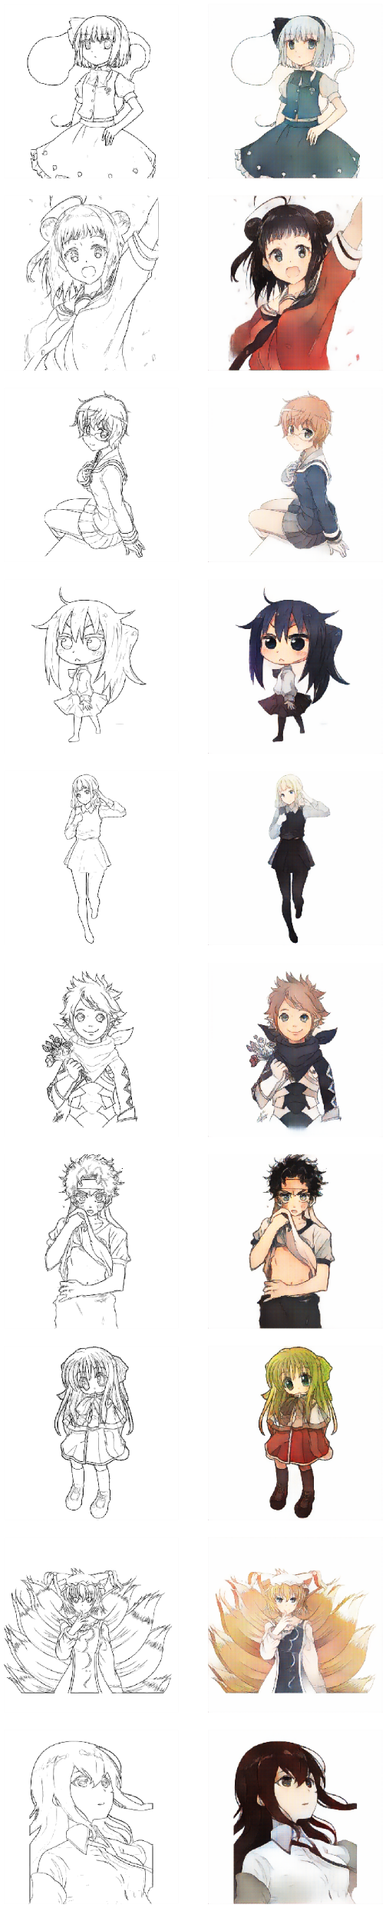
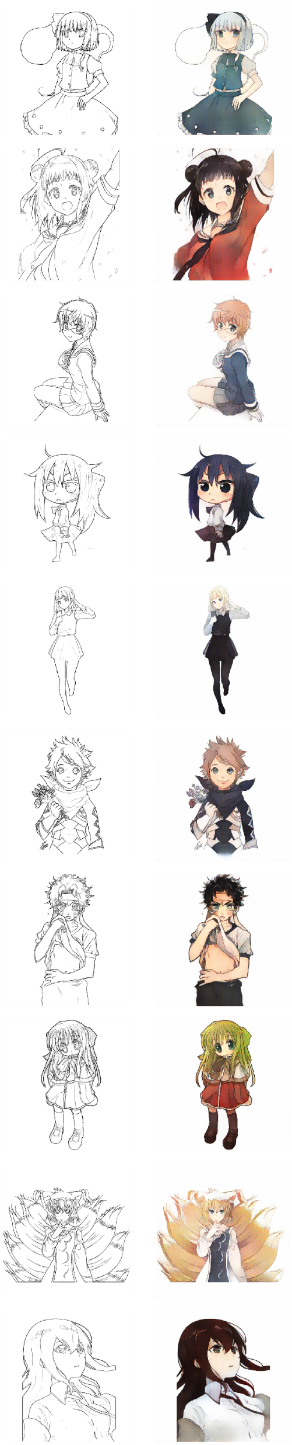
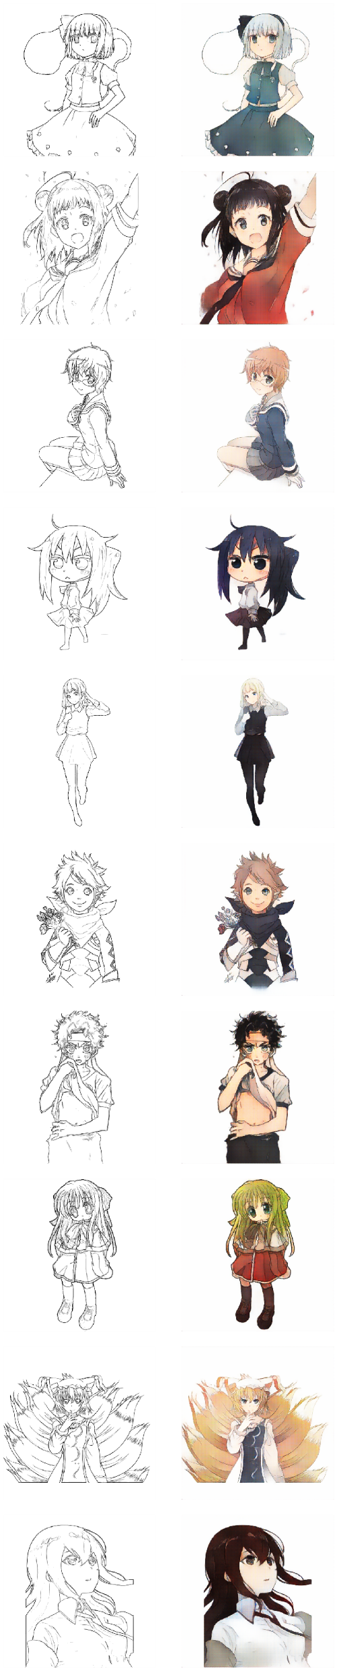
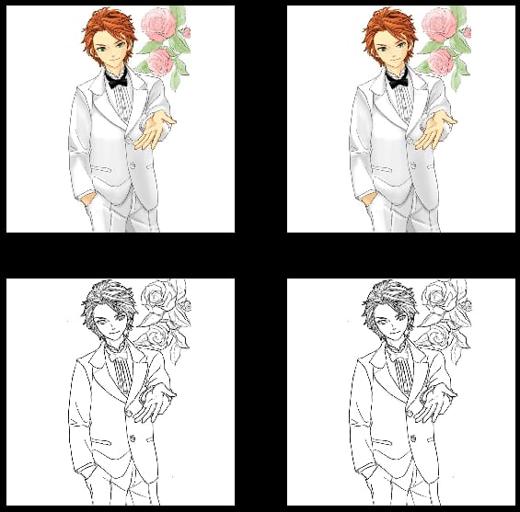
RESULT The result of the project is a cutting-edge tool that seamlessly translates rough anime sketches into vibrant and lifelike colorized images using Conditional Generative Adversarial Networks (cGANs). This tool revolutionizes the anime art creation process, saving time and effort for artists, enthusiasts, and professionals while fostering creativity and collaboration within the anime community. Its deployment across various platforms enhances accessibility and usability, making it a valuable asset for digital art creation and expression.

Slide 11

CONCLUSION
In conclusion, the development of the Sketch to Color Anime Translation Using c-GAN project marks a significant advancement in the field of digital art and image processing. By harnessing the power of c-GANs, we've created a versatile tool that seamlessly transforms rough anime sketches into vibrant and realistic colorized images. This project not only streamlines the coloring process for artists and enthusiasts but also fosters creativity and collaboration within the anime community. The successful deployment of the tool across various platforms enhances accessibility and usability, democratizing the creation of anime-style artwork. Moving forward, continued refinement and iteration based on user feedback will ensure that the tool remains a valuable asset for digital artists, animation studios, and anime enthusiasts worldwide, contributing to the ongoing evolution of digital art and creative expression.

